Slide 1
MERGE SORT EXAMPLES

Slide 2
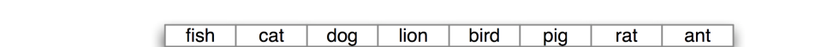
Guess the next step before going to the next slide

Slide 3

Guess the next step before going to the next slide

Slide 4
Guess the next step before going to the next slide

Slide 5
Guess the next step before going to the next slide

Slide 6
Guess the next step before going to the next slide

Slide 7
Guess the next step before going to the next slide

Slide 9
What if the array has an odd length?

Slide 10
